Slide 1



CDFHS OPEN DAY
December 5th, 2016 WELCOME TO YOU ALL
Charity Number: 1112344
Company Limited By Guarantee Number: 5559147

Slide 2

























Slide 3
CDFHS OPEN FOR BUSINESS
THE YEAR TO DATE SEES US TURNING OVER £300,000
WE EXPECT TO DO £1/2 A MILLION BY APRIL 2017
CDFHS HAS 5 TRUSTEES
WORKFORCE OF NEAR 60 PAID WORKERS AND VOLUNTEERS
WE STILL HAVE THE CORE PRINCIPLES OF LOW COST FURNITURE
CDFHS STILL RUNS ITS ROBUST TRAINING AND EMPLOYMENT PROJECT
Charity Number: 1112344
Company Limited By Guarantee Number: 5559147

Slide 4
Running in the Background over 2016 was
BIG POTENTIAL FROM NATIONAL LOTTERY £66,000
LED TO SOCIAL INVESTMENT AND READYING THE CDFHS FOR THIS OVER A 6 MONTH PROGRAMME
THE CONTRACTOR FROM SIB AND LOTTERY WAS N4G
N4G EVENTUALLY HELPED CDFHS COMPLETELY DOCUMENT AND PREPARE FOR INVESTMENT READINESS
THIS TOOK US TO THE INVESTMENT MARKET SEPTEMBER
SOCIAL INVESTMENT TO VALUE £750,000 RAISED

Slide 5

The Big Potential
Being Big Potential investment ready meant our organisation would acquire the input to enable us to have the systems, processes and business model to attract investment.
We bid to Lottery and won one of the first ADVANCED Big Potential grants in the North East
We needed to develop a fully integrated investor focused business plan,
Financial modelling to project income & expenditure, cash flow and balance sheet models to the standard expected by banks and investors.
Social impact and to understand the social impact that their interventions are responsible for and help them to embed suitable reporting systems
We were led to Northstar Ventures by our investment intermediaries Numbers For Good appropriate funders and investors through to financial close, including due diligence support.

Slide 6




Who we work with
Social enterprises and charities
Investors
Public sector commissioners

Slide 7

Through Big Potential advanced we looked for the most appropriate and best fit for our plans and work needed that was beyond our capacity to deliver
Numbers for Good bridges the world of finance to organisations dedicated to improving people’s lives and helping the planet.
N4G created financial solutions that allowed CDFHS to connect us to investors with opportunities for financing our major objective of buying our own facility.

Slide 8
N4G has got us to an investment ready position
CDFHS raised finance to:
Develop our own independent facility
To be custom adapted and make us and our shopping much more attractive to customers
Grow our range of competitively priced goods
It will be in a better location, bigger and a fully owned asset

Slide 9
&
Northstar Ventures
  Fund manager for the North East Social Investment Fund
  Supporting sustainable Social Enterprises in North East
  Encouraging Social Enterprises to develop greater Social Impact for disadvantaged communities and individuals
  Offering flexible, tailor-made repayable finance options

Slide 10
&
Northstar Ventures - Pleased to be working with CDFHS
  Delivering more than financial support
  Building strong partnership
  Working together to develop CDFHS growth potential
  Supporting and providing solutions to challenges faced by CDFHS

Slide 11
Property and Future
PROPERTY SOUGHT AND INITIALLY FOUND
LOCATED IN BISHOP AUCKLAND
24000 SQUARE FEET
MAJOR ROOFING WORKS AND URGENT REMEDIALS NEEDED
SURVEYS VALUATIONS, PREPARATORY WORK ENGAGED IN
LAWYERS AND PROJECT TEAM ENGAGED
Gazumped just before completion and now we are back looking for a suitable facility
PROOF WE LIVE IN THE REAL WORLD OF DOG EAT DOG!

Slide 12
Though on an ongoing basis
ONGOING THOUGH IN TO 2017
NEW RANGE OF WHITEGOODS –MONTPELLIER AN UP AND COMING NEW BRAND
THIS IS MARKETED BY DOMESTIC APPLIANCE DISTRIBUTORS AND US
SEE OUR PROMOTIONAL STAND
FULL RANGE of BUDGET AND MORE UPMARKET BEDS
GROWING RANGE OF NEW WARDROBE / DRAWER SETS
WE WILL DEVELOP INNOVATIVE FINANCIAL SOLUTIONS TO ENABLE OUR CLIENTELE THE ABILITY TO ACQUIRE THESE GOODS

Slide 13
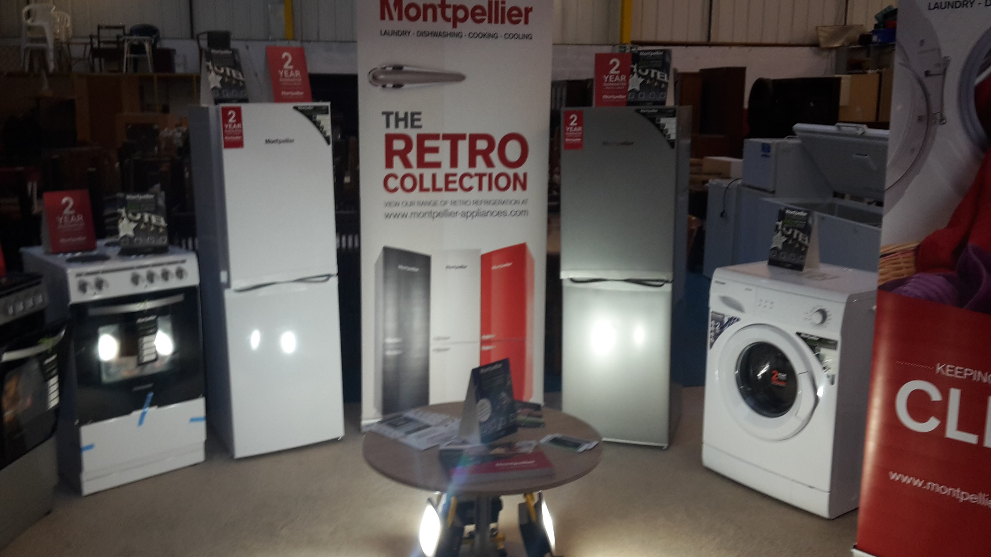

Slide 14
What we've done and are doing in our core day to day work
EXPANDED OUR STOCK OF RE-USE GOODS - 40 tonnes quarter
CREATING OPPORTUNITIES FOR DIVERSIFICATION DEVELOPMENT AND CHANGE
“SHABBY CHIC”
RUSTIC GARDEN FURNITURE
HANDMADE PLANTERS AND POTS FROM RECYCLED MATERIALS
GOING OUT TO WIN WORK AND CORPORATE PARTNERSHIPS

Slide 15
Some Highlights
CDFHS Community Transport FOODBANK REFERRER
CONTRACT WAREHOUSING CARRIED OUT
FUNCTIONAL COURSES AND TRAINEESHIPS CARRIED OUT ON SITE IN CONJUNCTION PROFOUND
BECAME AN APPROVED PARTNER FOR “DURHAMWORKS”
RECOGNISED AS A QUALITY WORK EXPERIENCE VENUE
COLLECTION FACILITY AND ADVICE POINT FOR NE FIRST CREDIT UNION
GREENMOVE OUT – GMO OF DURHAM UNIVERSITY
EVEN LOOKING AFTER OUR WORKFORCE HEALTH

Slide 16
An example of CSR our joint working with University of Durham and Durham County Council Strategic Waste
PARTNERSHIP WITH THE UNIVERSITY, THE POLICE AND STREET WARDENS STUDENT UNION, COUNCILS STRATEGIC WASTE GROUP
UNIVERSITY STUDENTS “GREEN MOVE OUT” TO COLLECT AND REUSE SURPLUS GOODS ARISING FROM 2200 STUDENT LODGINGS
ALL UNIVERSITITY COLLEGES EXPECIALLY USTINOV AND HATFIELD
20 METRIC TONNES SURPLUS BELONGINGS, CLOTHES, BEDDING, CROCKERY, ELECTRICALS
REDISTRIBUTED TO HOMELESS CHARITIES, BOTH HUMAN AND NON-HUMAN
350 STUDENTS ATTENDED OUR ANNUAL SALE DAY OCTOBER 1ST AND BOUGHT IT ALL BACK!!
CSR

Slide 17
Other things
PAINT AND DECORATING SERVICE
HANDYMAN SQUAD AVAILABLE FOR EXTERNAL WORKS ACROSS THE COUNTY
NEW IT SUITE COMPLETED COURTESY 4 TOGETHER AREA ACTION PARTNERSHIP
MORE STAFF TRAINING DELIVERED BY PROFOUND TRAINING SERVICES
BETTER HEALTH AT WORK IN CONJUNCTION PIONEERING CARE PARTNERSHIP OF NEWTON AYCLIFFE

Slide 18
THANK YOU FOR SUPPORTING US

